Slide 1
CASE STUDY 2 – MSDS 6306
Jonathan Flores, Melissa Luzardo and Randy Park

Slide 2

DDS Analytics – “Attrition” Predictive Model
Project Description:
DDS executive leadership has identified predicting employee turnover as its first application of data science for talent management.
Request:
The team is tasked our data science team to conduct an analysis of existing employee data.

Slide 3
Methodology to make prediction model using lra
Predictions
Model Creation
Exploratory Data Analysis
Explore: Attrition vs All Variables
Try to find important variables and relevant trends
Clean and transform the information to a numeric data set
Evaluate Prediction Models against requirements
Split data set into training and data set
Create model and Reduced Model
Create Predictions using testing data set
Cross validation with testing data set
Study Results

Slide 4
EXPLORATORY DATA ANALYSIS
Includes some relevant variables

Slide 5
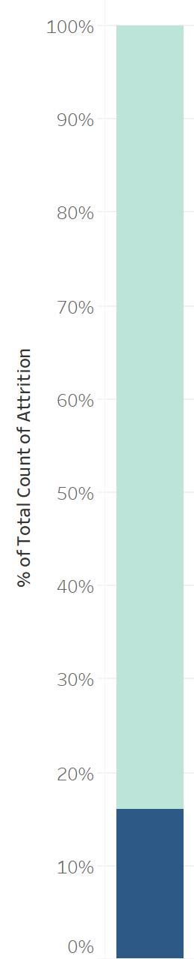
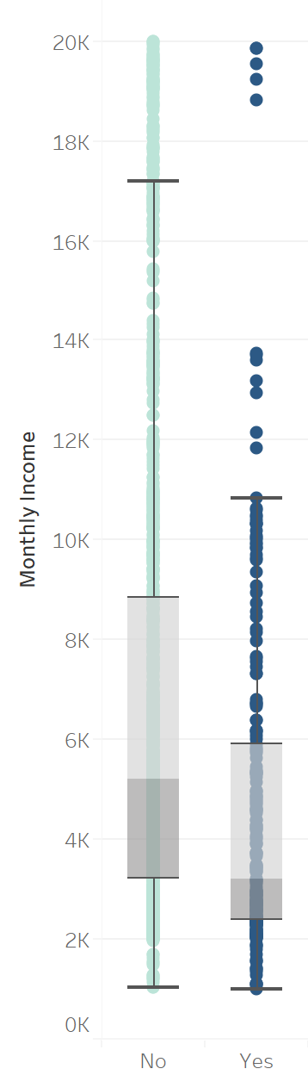
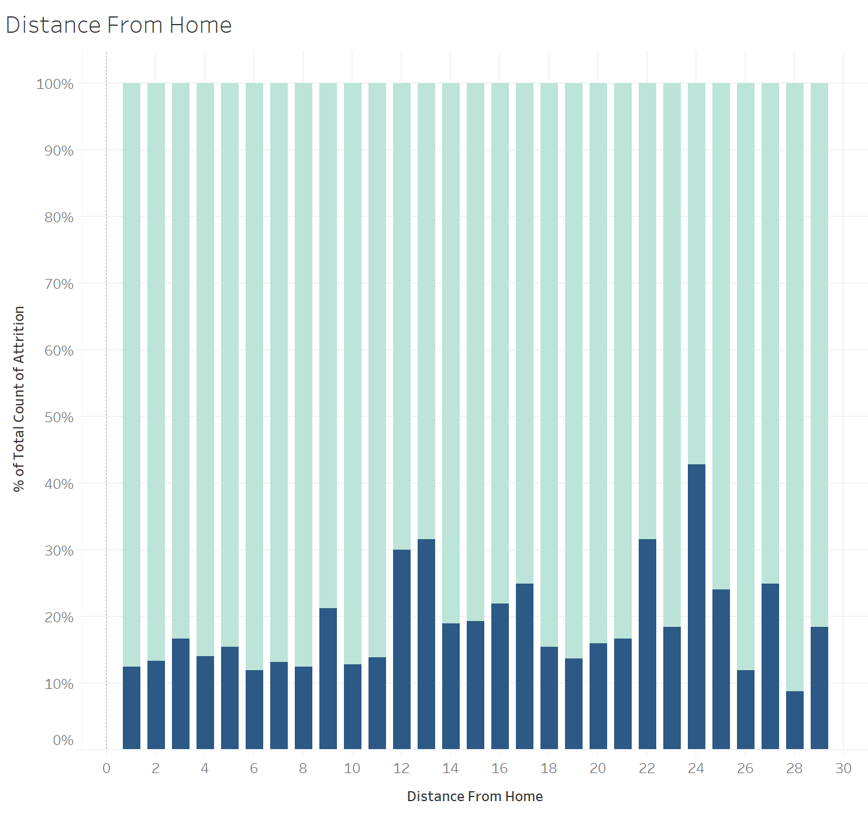
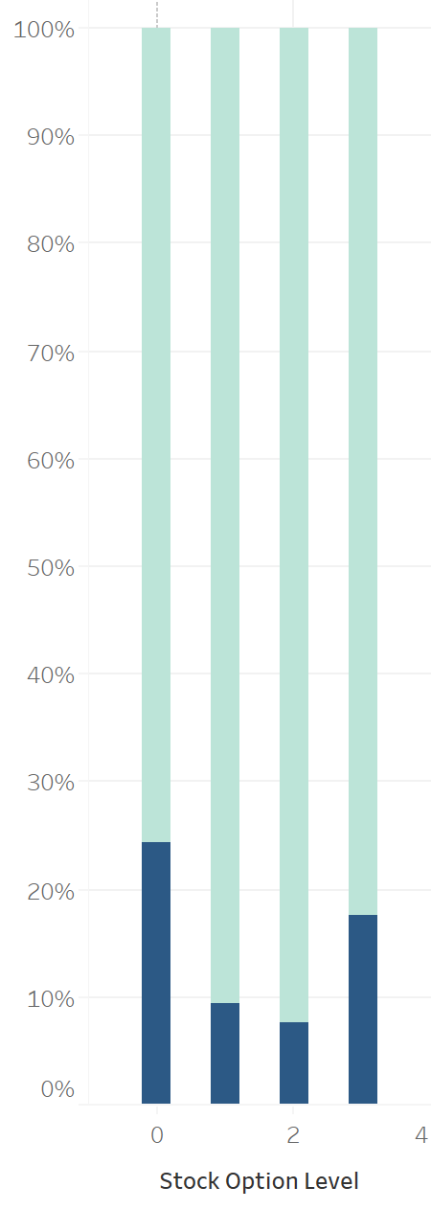
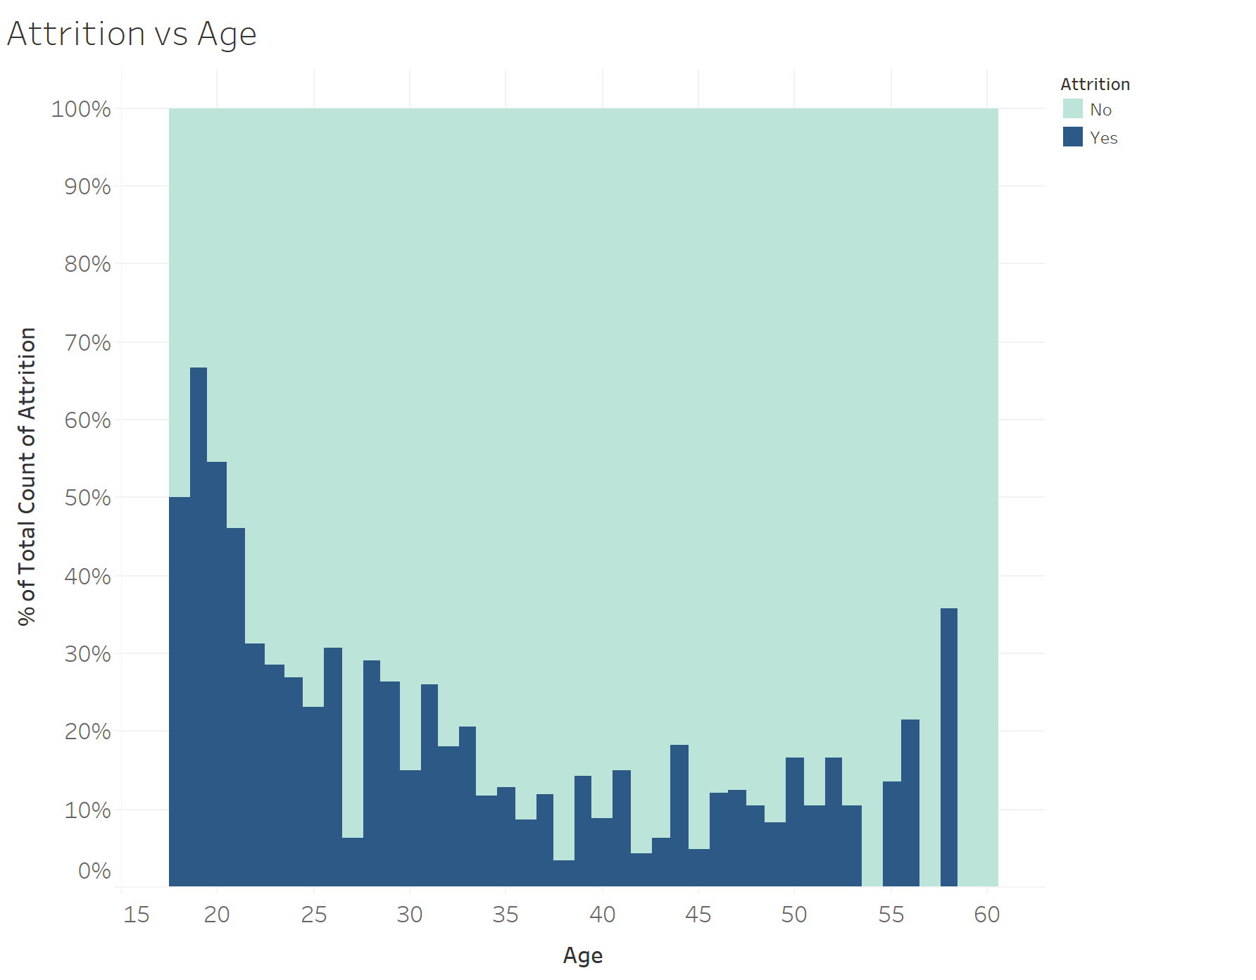
Attrition by: income, distance from home and stock option levels
Attrition
Monthly Income
Distance From Home
Stock Option Level
Attrition seems to happen with employees with lower monthly incomes
12, 13, 22, and 24 miles from home seem to have higher percentages than the rest. Closer to home has lower percentages of attrition
Not much significant attrition difference between stock option levels
Attrition is at 16%

Slide 6
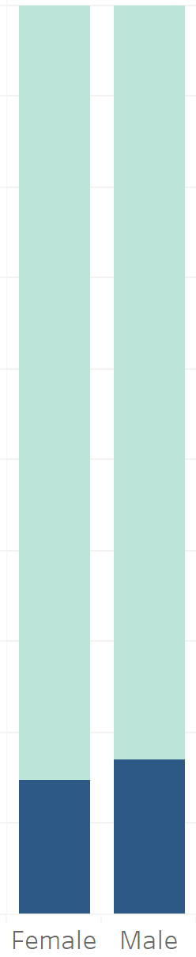
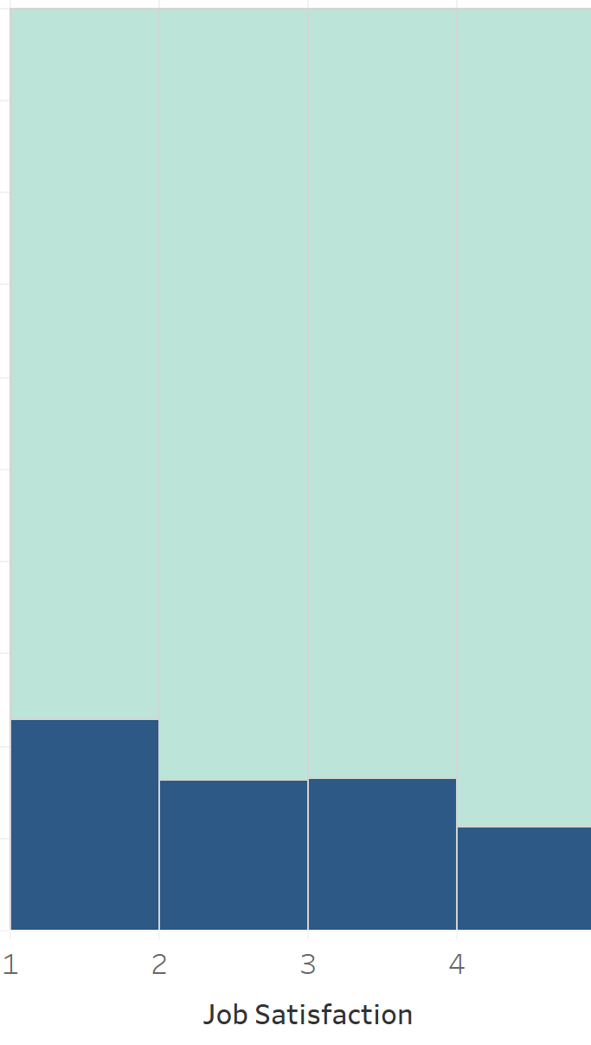
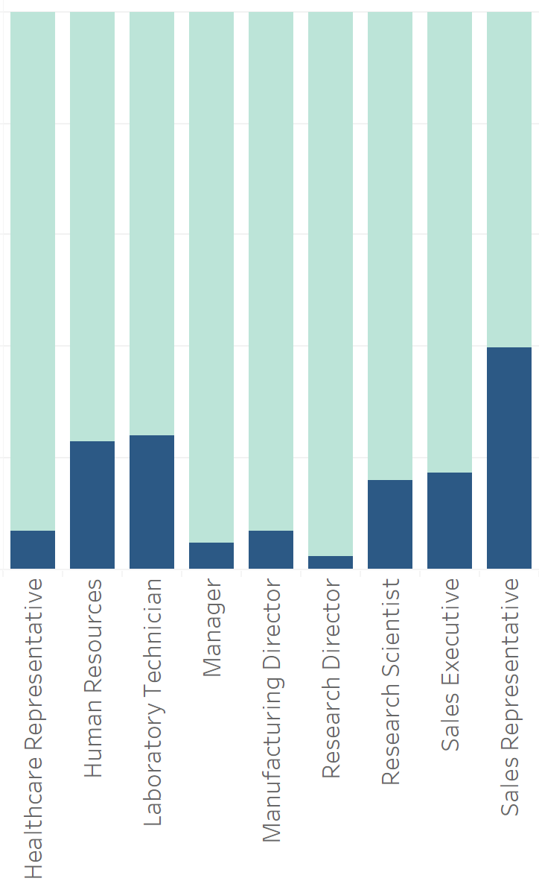
Attrition by: Age, gender, Job Satisfaction and job role
Age
Gender
Job Satisfaction
Job Role
Sales representative have the highest attrition at 40%. Then HR and Lab Tech. at 23% and 24% respectively
Employees in the ages from 18 to 21 tend to quit their job more than employees in different ages
Not much attrition difference. F: 14.8% and M:17%
Not much attrition difference between Job Satisfaction Levels

Slide 7
Model creation

Slide 8
Importance of a predictive model
The predictive model allows to combine all the variables

Slide 9
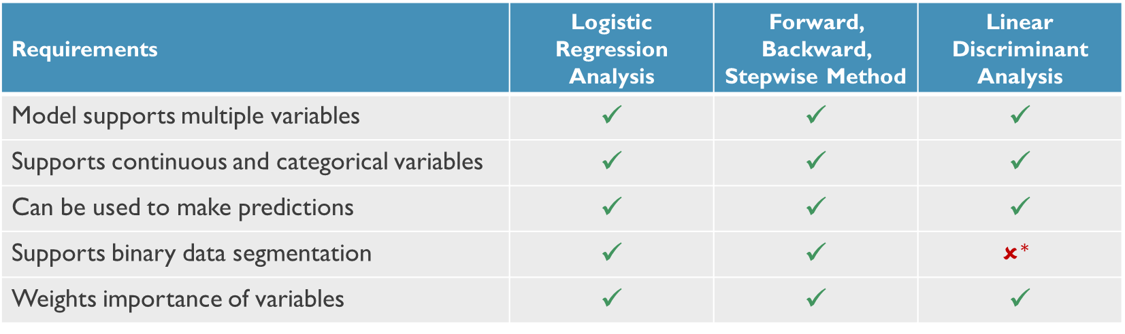
model Requirements, evaluation and comparison
Multiple models were reviewed and 3 of them met the met most of the requirements. Logistic Regression Analysis gave the best results
Requirements | Logistic Regression Analysis | Forward, Backward, Stepwise Method | Linear Discriminant Analysis
Model supports multiple variables | ✓ | ✓ | ✓
Supports continuous and categorical variables | ✓ | ✓ | ✓
Can be used to make predictions | ✓ | ✓ | ✓
Supports binary data segmentation | ✓ | ✓ | $$✗^{∗}$$
Weights importance of variables | ✓ | ✓ | ✓
*It is possible to use LDA model for binary predictions; however, LDA is best suited for more than two categorical predictions
Notes:
All models can predict attrition given our data set. Selected the logistic regression analysis.
Both LRA and F/B/S methods are probability models. Only LDA is a machine learning model

Slide 10
Logistic Regression analysis – final model
KPI (1 of 2) | Estimate | Probability
Over Time - Yes | 2.002 | 7.59E-21
Job Satisfaction - 4 | -1.441 | 8.06E-07
Marital Status - Single | 1.456 | 1.39E-06
Environment Satisfaction - 4 | -1.267 | 6.61E-06
Years Since Last Promotion | 0.2028 | 3.15E-05
Distance From Home | 0.04841 | 4.23E-05
JobRoleSalesRepresentative | 2.195 | 7.01E-05
**EnvironmentSatisfaction3** | -0.9925 | 0.0002872
**EnvironmentSatisfaction2** | -1.101 | 0.0004351
**JobRoleLaboratoryTechnician** | 1.679 | 0.0004873
**JobInvolvement4** | -1.743 | 0.000664
**JobInvolvement3** | -1.223 | 0.001263
**TrainingTimesLastYear** | -0.2507 | 0.001918
**JobInvolvement2** | -1.22 | 0.002915
**JobRoleHumanResources** | 1.803 | 0.003652
**RelationshipSatisfaction4** | -0.808 | 0.004164
**JobRoleSalesExecutive** | 1.323 | 0.005139
KPI (2 of 2) | Estimate | Probability
**YearsWithCurrManager** | -0.1448 | 0.005414
**WorkLifeBalance3** | -1.111 | 0.00638
**YearsInCurrentRole** | -0.1422 | 0.006733
**RelationshipSatisfaction2** | -0.8518 | 0.007649
**RelationshipSatisfaction3** | -0.7248 | 0.009146
**JobSatisfaction3** | -0.685 | 0.01102
**NumCompaniesWorked** | 0.1071 | 0.01271
**JobRoleResearchScientist** | 0.7686 | 0.1126
**JobSatisfaction2** | -0.4199 | 0.159
**WorkLifeBalance2** | -0.5628 | 0.1929
**WorkLifeBalance4** | -0.625 | 0.202
**MaritalStatusMarried** | 0.3468 | 0.2368
**YearsAtCompany** | 0.02915 | 0.4699
**JobRoleResearchDirector** | -0.5145 | 0.5693
**JobRoleManufacturingDirector** | 0.269 | 0.6412
**(Intercept)** | 0.3174 | 0.7546
**JobRoleManager** | -0.1384 | 0.8604

Slide 11
Predictions and results

Slide 13
appendix

Slide 14
Executive summary
Analysis Repository
Data Set
Data set contains 32 variables (including attrition)
Analysis
Please see analysis repository in R, for details
Predictive Model
1,470 observations
The data set contains discrete, continuous and categorical variables
17 variables are categorical

